Slide 1
Communicative English Faculty – Dr. Kiran Magavi Department – Humanities and Social Sciences
Group Discussion Skills

Slide 2
What is a group discussion ?
Group discussion is a method used by an organization to measure whether the candidate has convinced individuality traits and skills that it desires in its teammates.
In this method, the group of candidates is given a topic or a situation, given a few minutes to consider about the same, and then asked to discuss the topic amongst themselves for 15-20 minutes.

Slide 3
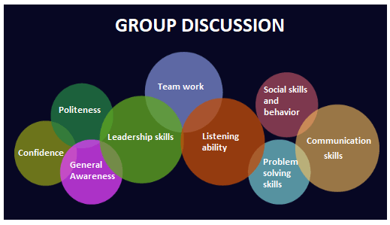
GD Skills required

Slide 4
Aspects that support a group discussion
They are:
Co- operation
Verbal Communication
Non- verbal behaviour
verification to norms
Decision-making aptitude

Slide 5
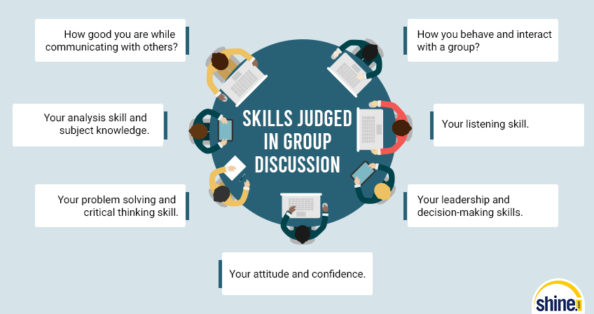

Slide 6
Knowledge
Knowledge a candidate possesses is the capability to have an estimation on issues and facts and how he/she applies it to the topic discussion
Knowledge is a sharp differentiator and is a great advantage
Unless one has the necessary knowledge of the given topic, the quality of the group discussion can be low and at the surface level.
Being well versed in present affairs and issues of simultaneous importance can help to do well.

Slide 7
Interpersonal skills
It is reflected in the aptitude of the candidate to interrelate with other members of the group in an amicable and concise manner.
Emotional smoothness and stability promote high-quality interpersonal relationships.
The person has to be more group-centric and less self-centered.

Slide 8
Proactive
If you have content to speak, don’t wait for others to start with the group discussion.
The one who gets an opportunity to speak first gets an opportunity to drive the Group discussion.
There may come a time where other members are not speaking up, that time you can take a proactive step and ace your group discussion round.

Slide 9
Leadership
Among the large number of brilliant candidates, there’s always a possibility of getting overshadowed.
It could be a case where, if there is a candidate who is not as much well-informed or good at academics, but his or her excellence of putting forth the points and has an aptitude to manage the circumstances well, will make him/her earn a good point.

Slide 10
Time Management
Time is one of the innermost things.
Its correct use can take you to heights, and its disregard can make you fall on the land.
During the group discussion, make yourself definite that you will speak not less than two minutes.

Slide 11
Logical Ability
This indicates your aptitude to efficiently flowchart you’re thought process and examine the topic in a comprehensive manner.
It reflects your aptitude to build logical arguments and makeup the discussion in a sleek manner, avoiding deviations and beating round the bush

Slide 12
Communication skills
This evaluates the candidate's aptitude to attach with the group and is calculated from a dual viewpoint - verbal and non-verbal.
Verbal communication is judged by the candidate’s articulation and intonation, expression of points
Non-verbal quotient defines his/her body language, signal eye contact and bearing.

Slide 13
Group dynamics
This demonstrates the skill to maintain stability between individual brilliance and group performance.
A person scoring high on this parameter will be more credible to work in groups and hence contribute successfully to organizations.

Slide 14
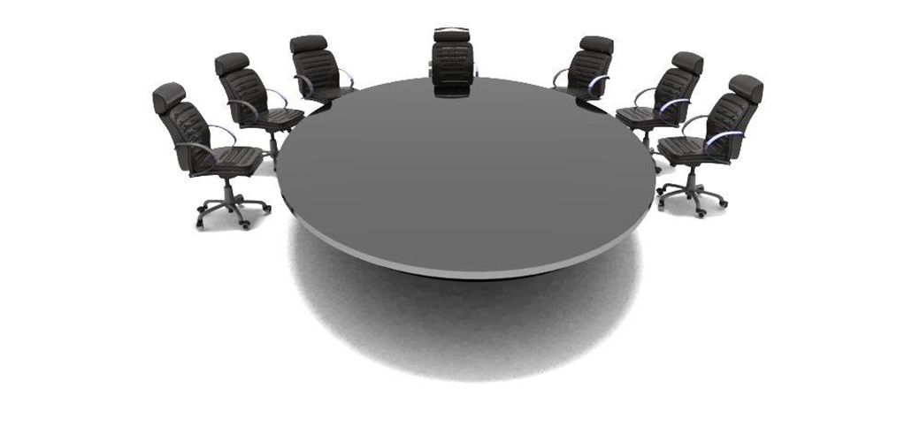
Regular , conventional seating arrangement

